Slide 1
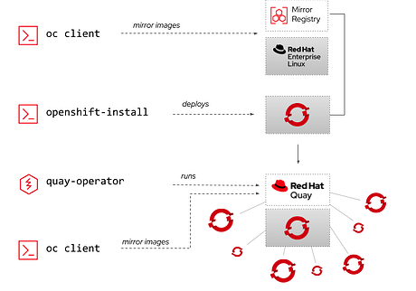
Mirror Registry FOR OPENSHIFT
Glenn West (gwest@redhat.com)
May 3, 2022

Slide 2
Why?
Mirror Registry is a minimal streamlined deployment of Quay on a single node with local disk.
Provides a quay registry for disconnected install and bootstrap of cluster.
Designed as a “appliance” that runs on RHEL 8 and Podman 8
Configurs mirror registry on local machine or a given target host
Setup for auto-start
Really useful in lab/developer for quick repeatable installs

Slide 3
SLA / Downside
Update is tied to uptime of a single host running it, clustered deployments are not supported (If needed use Red Hat Quay)
Storage is local filesystem strage with no bult-in replication, only store images that can easily be downloaded again if don’t have a SAN
Mirror Registry Down cannot:
Perform cold start (kubelet dependency )
Add additional nodes or reboot nodes
Update to newer versions / update OLM Operators
Perform node maintenance / failover workloads (unless images in cache)

Slide 4
Intended Usage
Its Not For
OpenShift Core images
Openshift clients
Operator Catalogs
Sample image streams
Custom monitoring agents
Service few or single OpenShift Hub Cluster
Custom Application Images
Production business workloads
Non-Infrastructure clusters that require high availability
Cluster that are frequently scalled in size
Single Node Clusters (Boot Dependency)
Serving many clusters as central registry

Slide 5
Leasons learned
Use RHEL 8.5 VM or bare metal dedicated host
It burns storage like it going out of style – Make sure your disk size is big enough (Mine is VM, but had to resize after install).
Install podman (yum install podman) first
Clients can be pulled from download version.
Must do login for the mirror to work
Must edit install-config.yml to use the registry

Slide 6
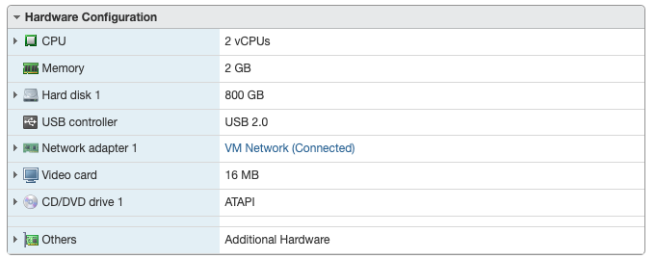
My COnfig
Vm on ESXI 7.0
2 cpus
2 GB memory
800 GB Disk
Confirgured as: registry.gw.lo

Slide 7
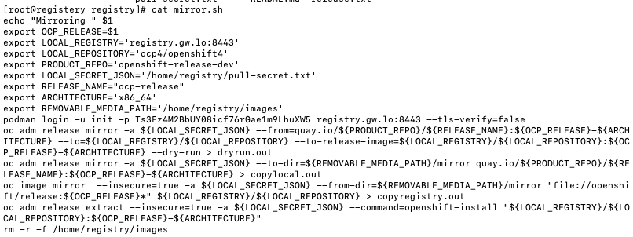
How to Mirror

Slide 8
Demo of mirroring
Runn mirror.sh on registry machine
Takes about 5-10 minutes
Script example is at:
https://github.com/glennswest/mirrorregistry/blob/main/mirror.sh
Known Issues:
Oc release mirror does not return failing error code if error occurs
(I don’t check in example anyway) (Customer reported bug)

Slide 9
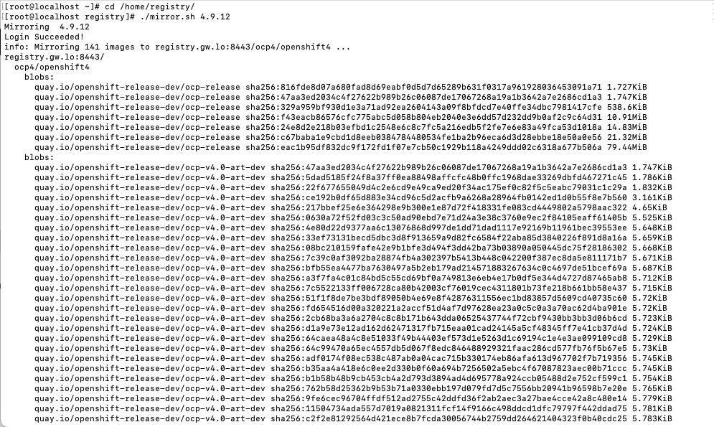

Slide 10
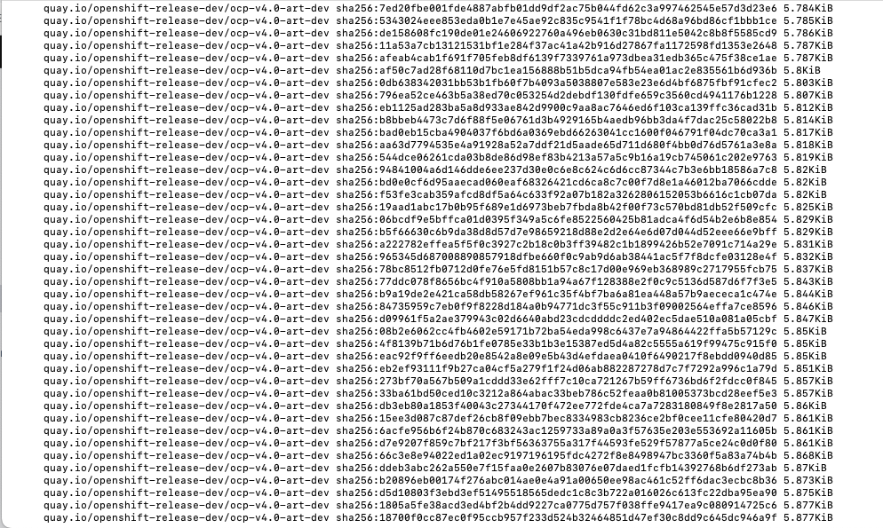

Slide 11
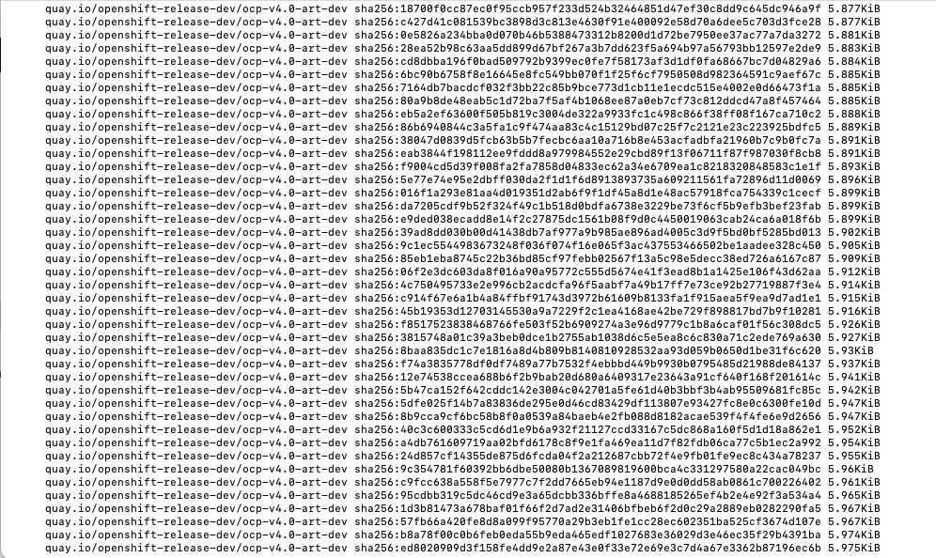

Slide 12
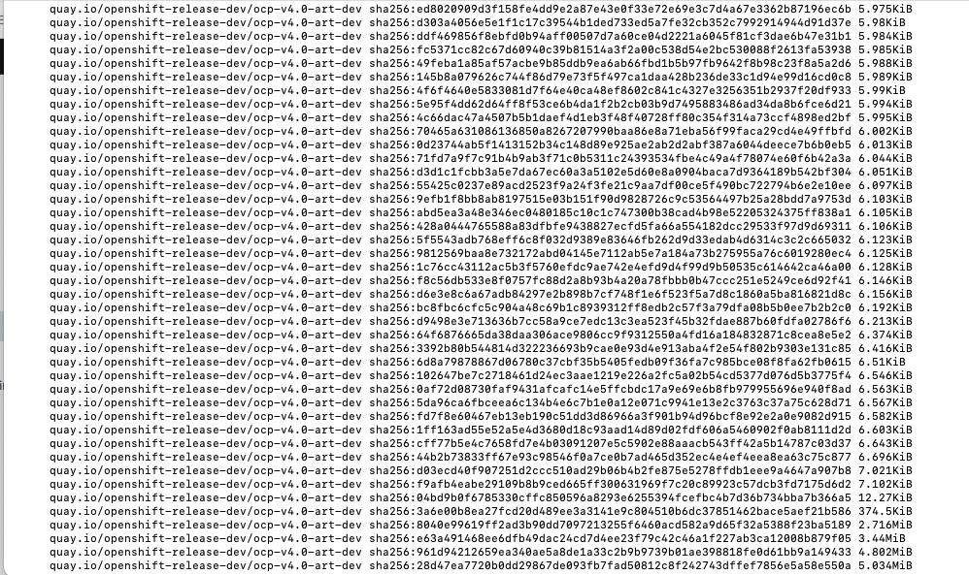

Slide 13
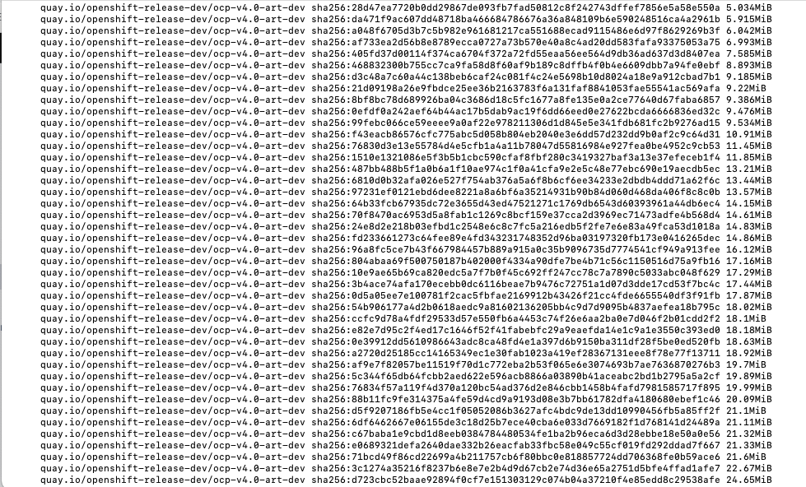

Slide 14
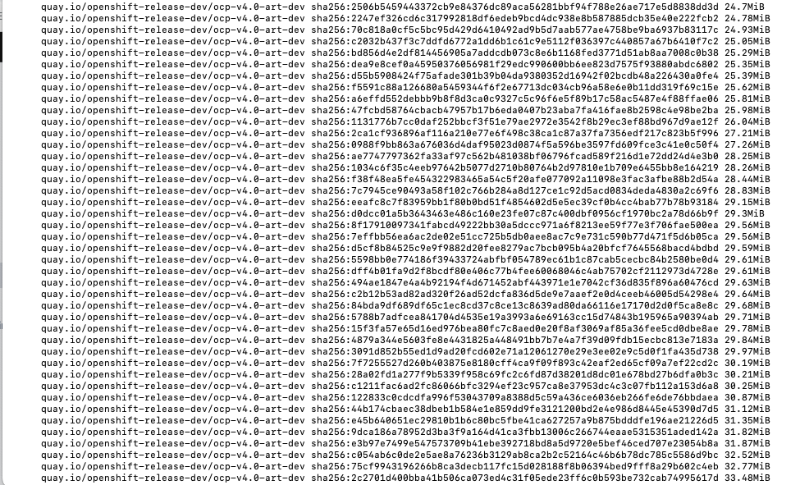

Slide 15
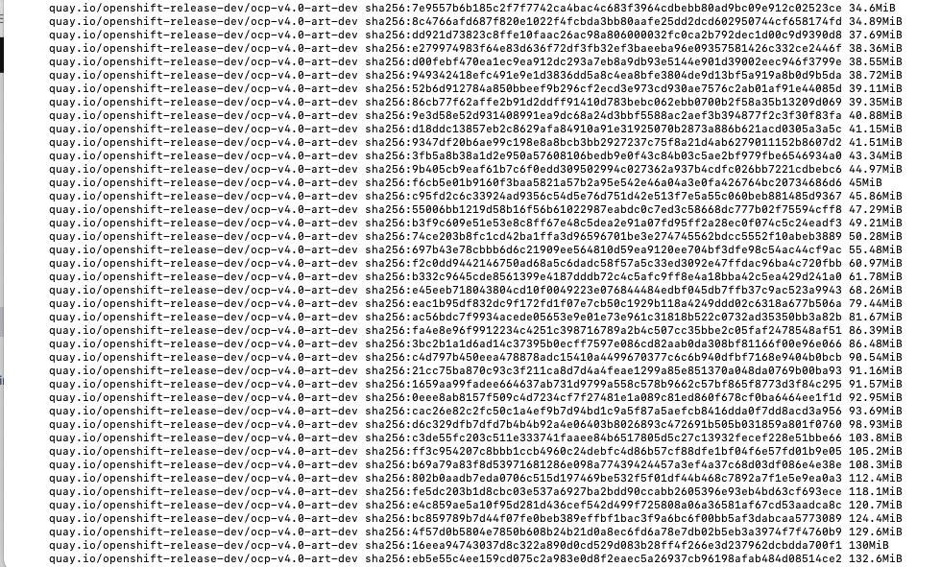

Slide 16
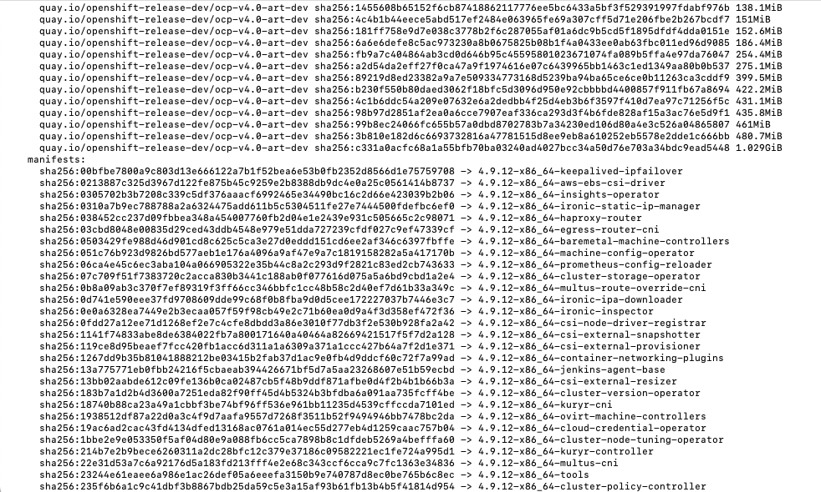

Slide 17
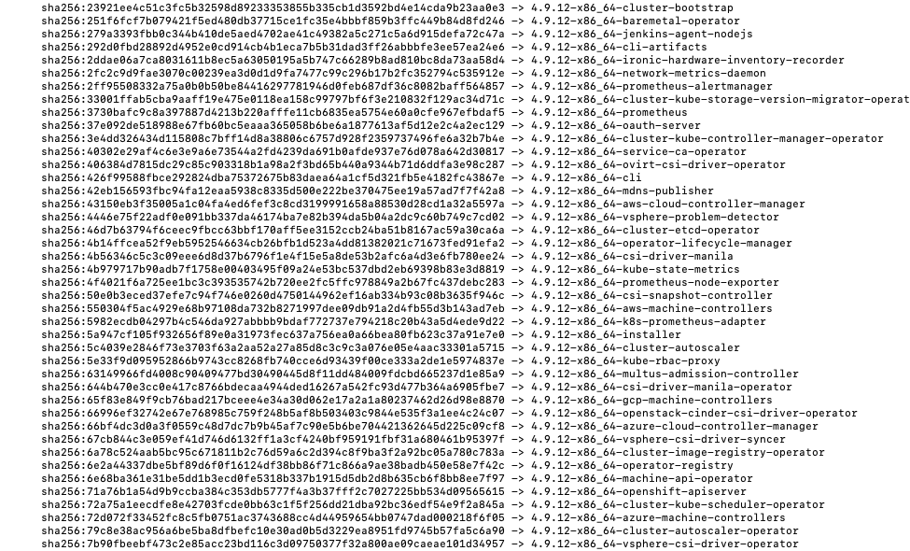

Slide 18
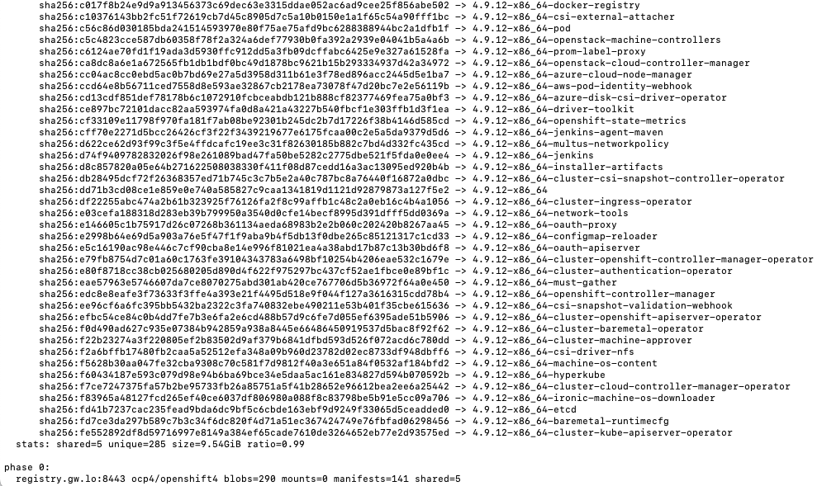

Slide 19
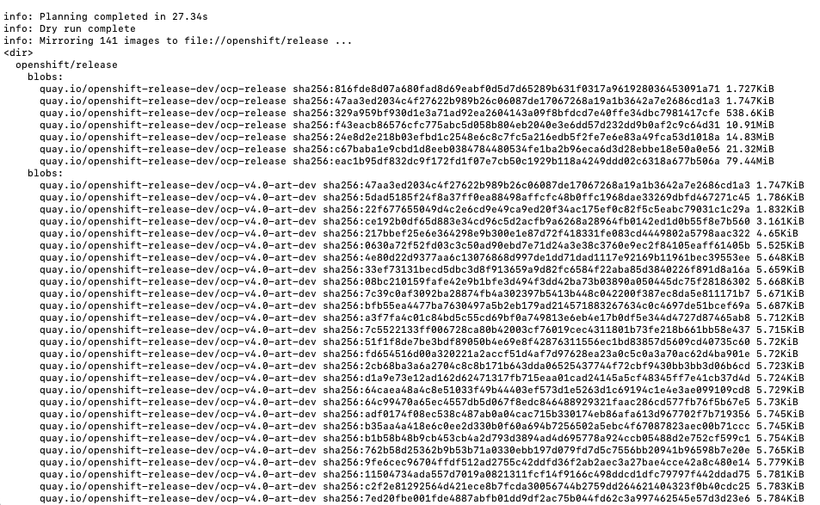

Slide 20
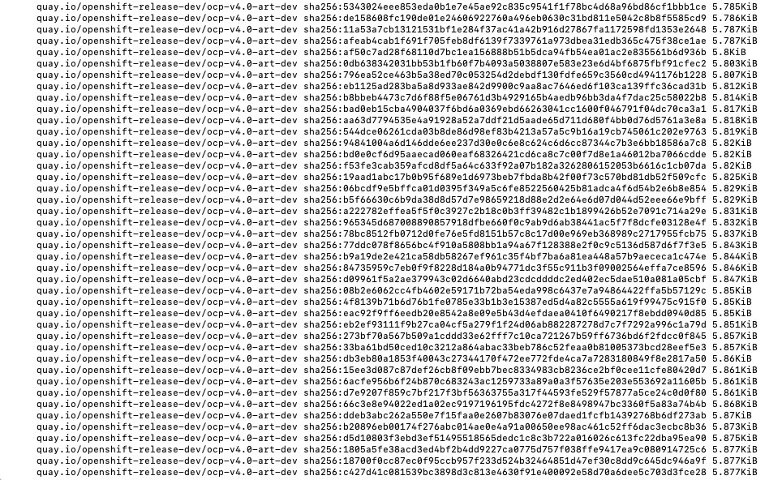

Slide 21
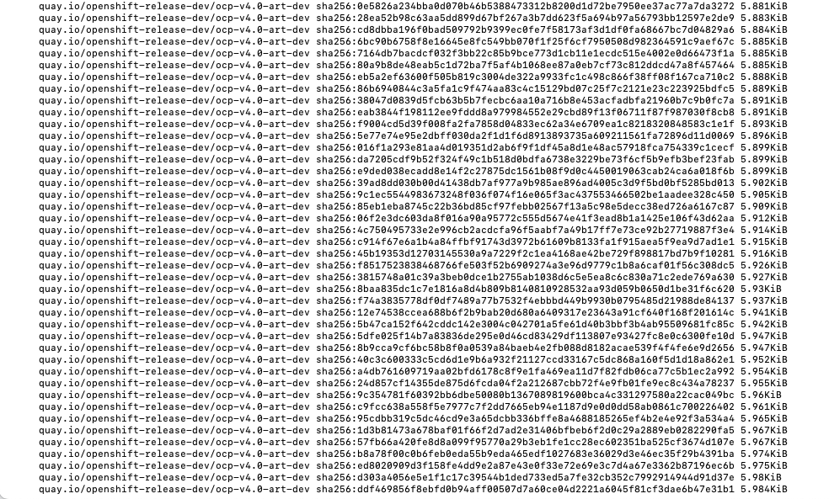

Slide 22
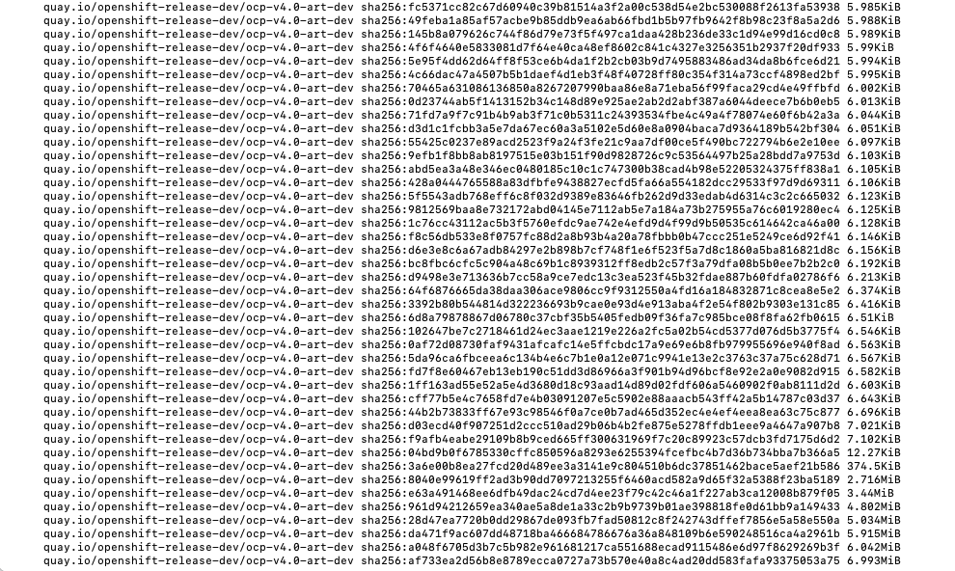

Slide 23
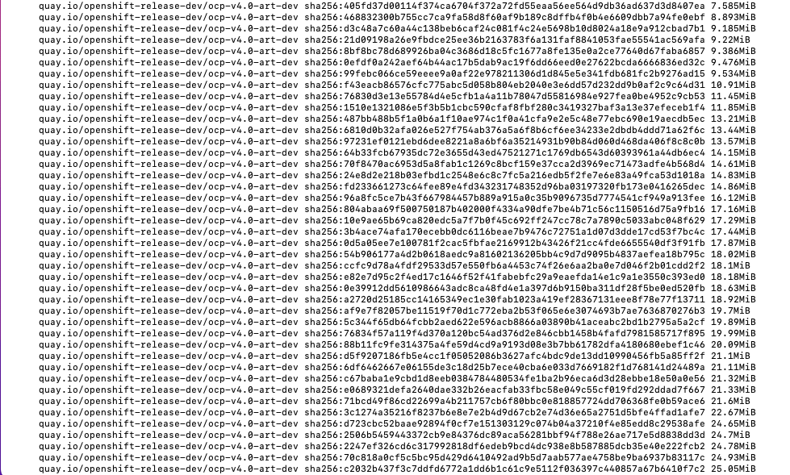

Slide 24


Slide 25
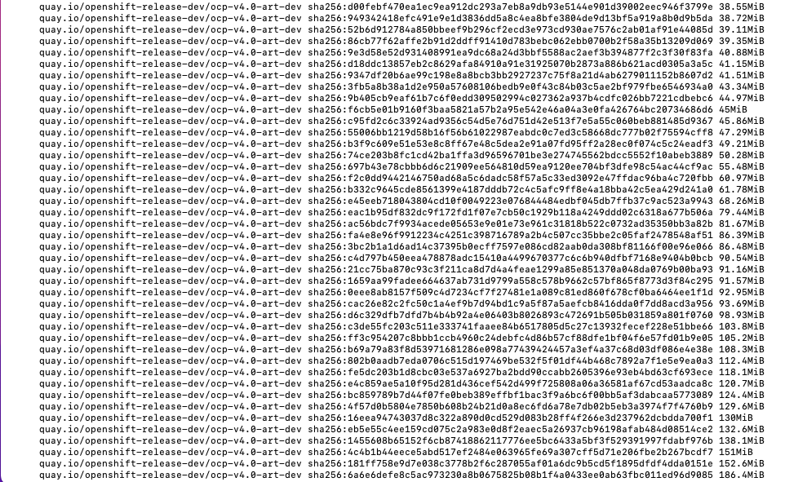

Slide 26
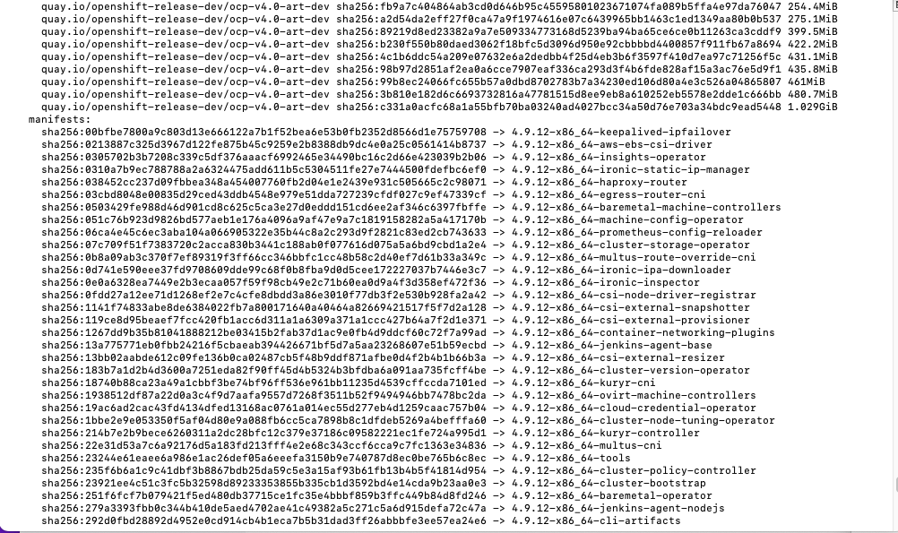

Slide 27
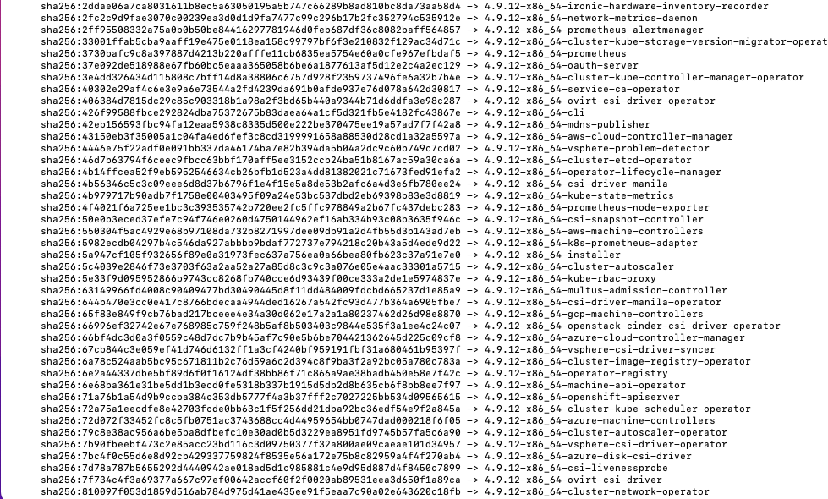

Slide 28
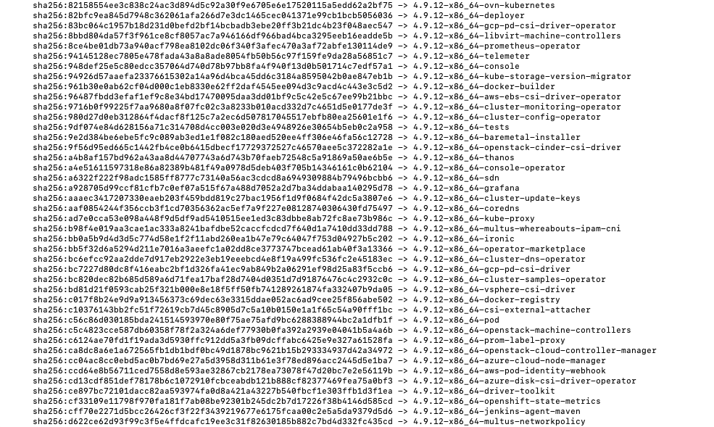

Slide 29
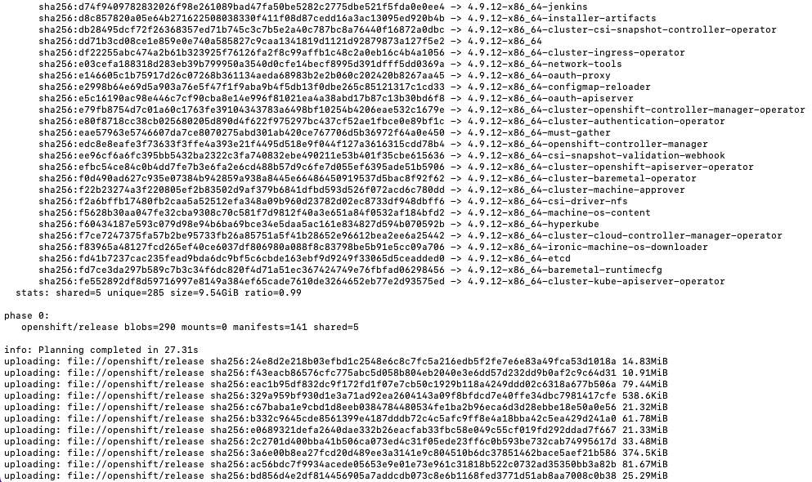

Slide 30


Slide 31


Slide 32


Slide 33
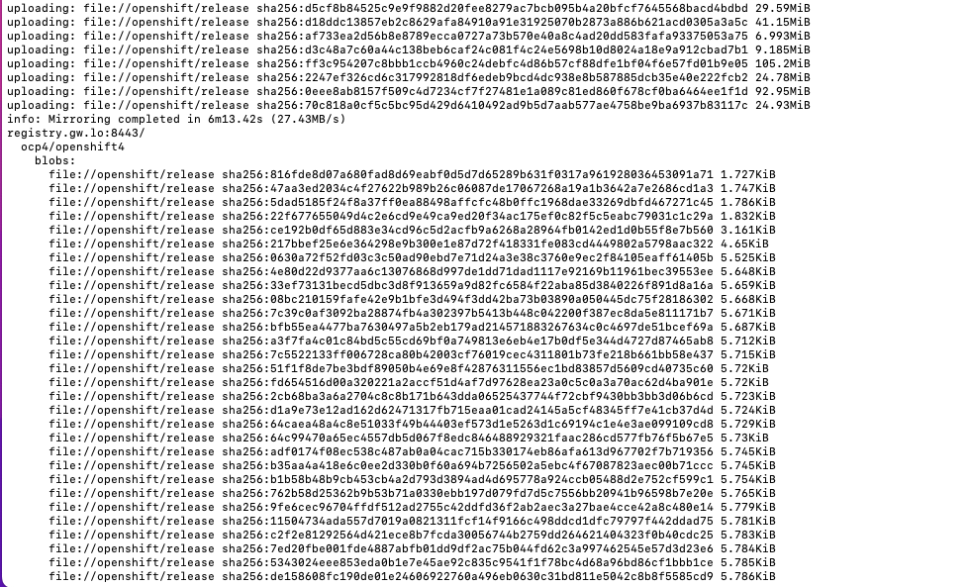

Slide 34


Slide 35


Slide 36


Slide 37


Slide 38


Slide 39
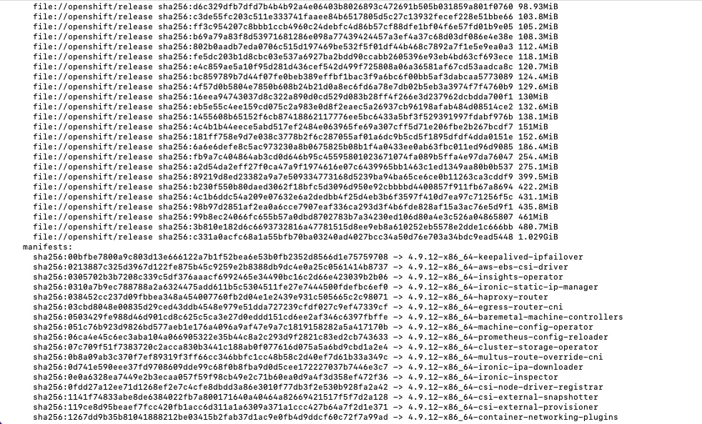

Slide 40
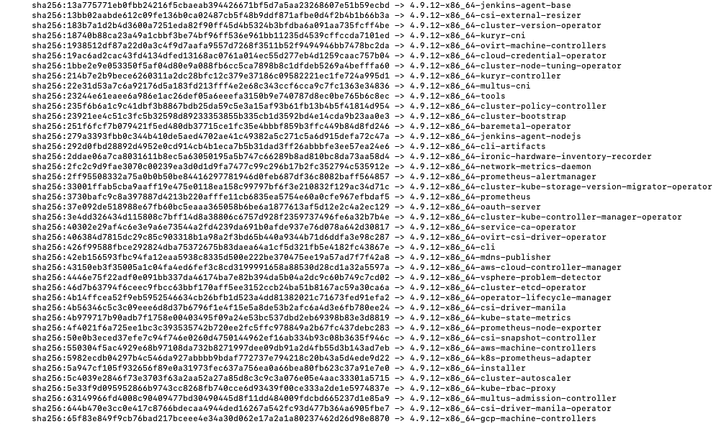

Slide 41
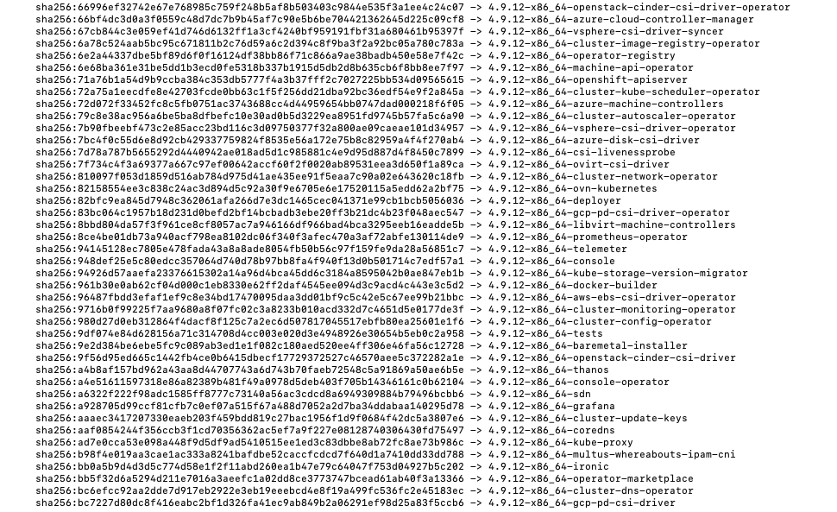

Slide 42
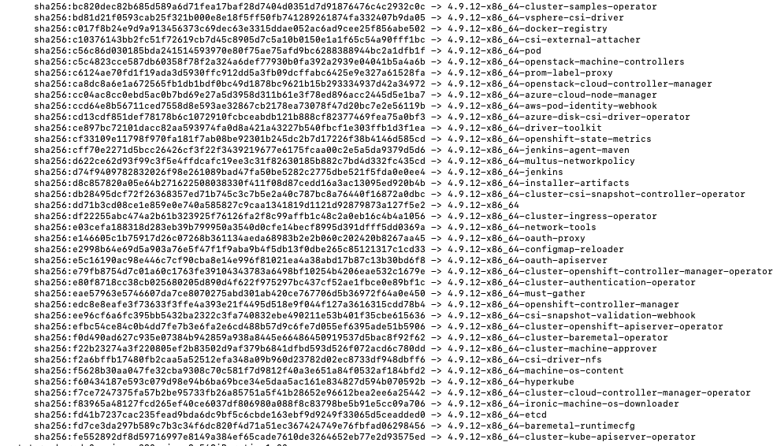

Slide 43
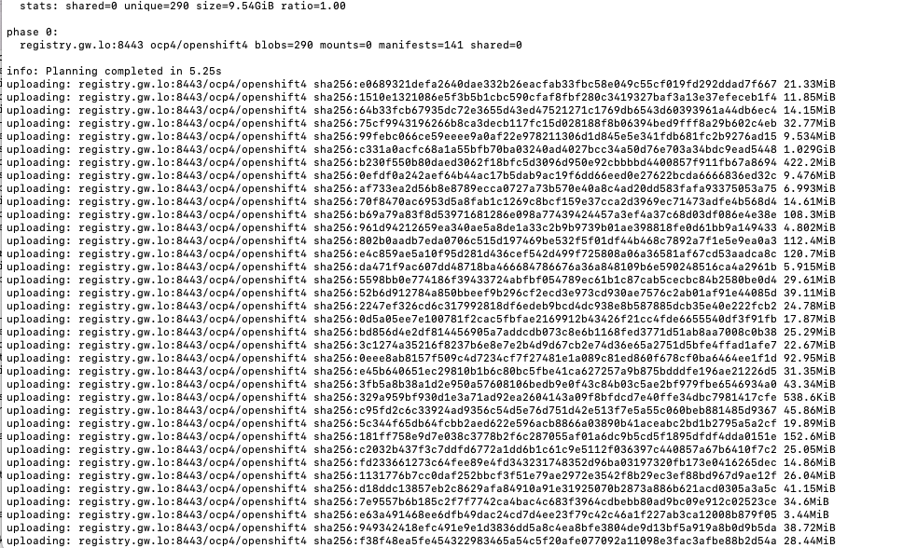

Slide 44
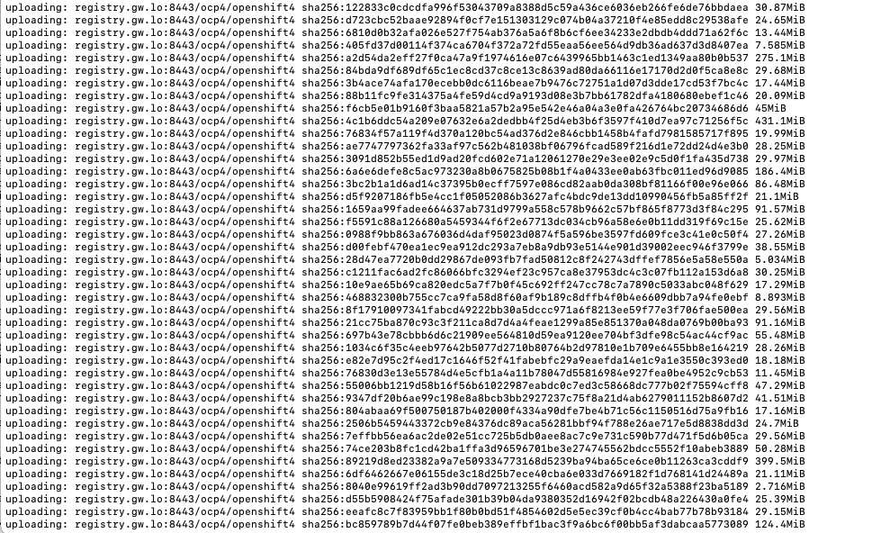

Slide 45
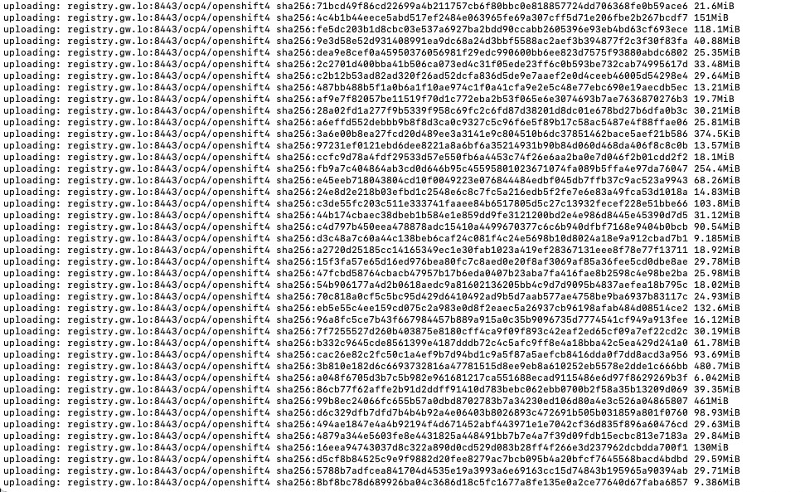

Slide 46
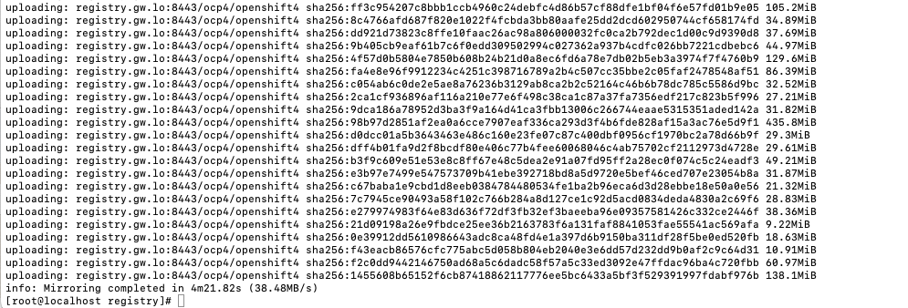

Slide 47
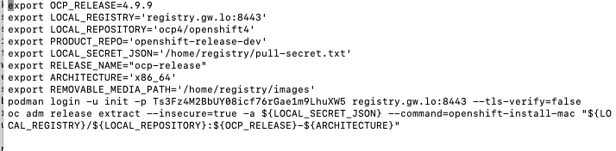
Ready to do install
Can pull the installer from downloaded image

Slide 48
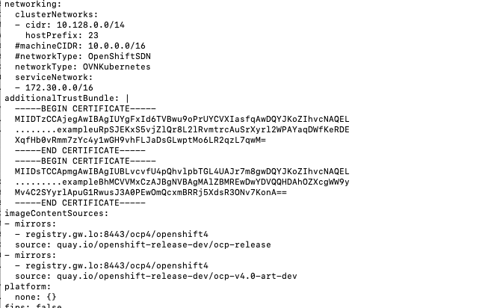
CHANGES TO INSTALL-config.yaml

Slide 49
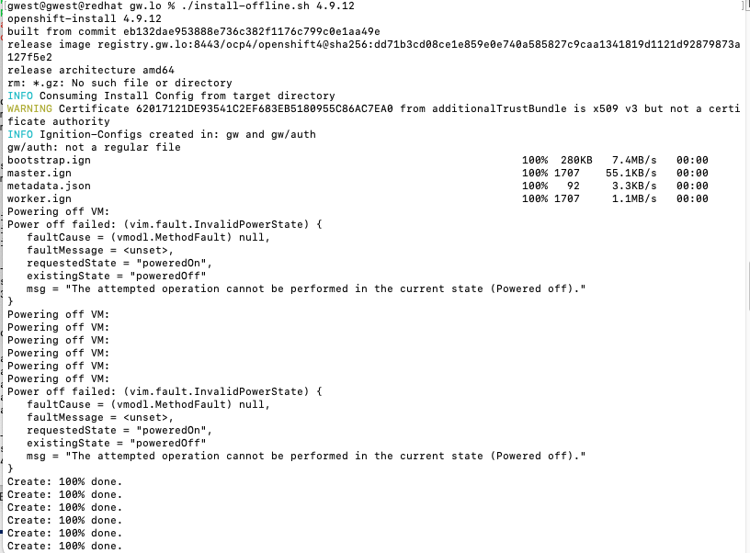

Slide 50
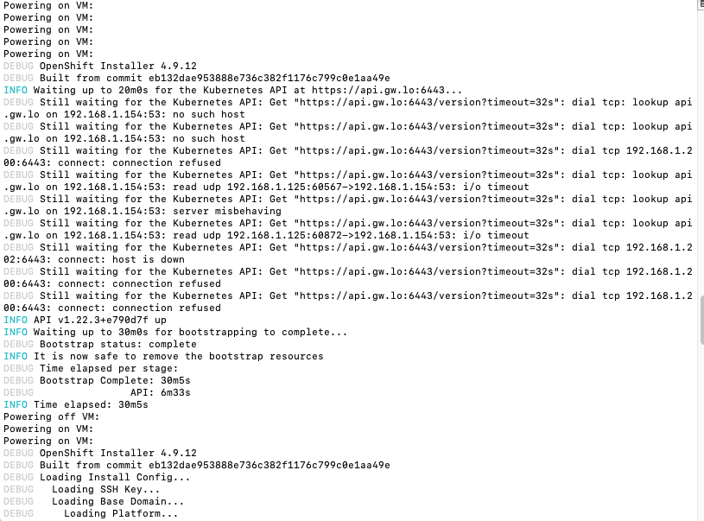

Slide 51
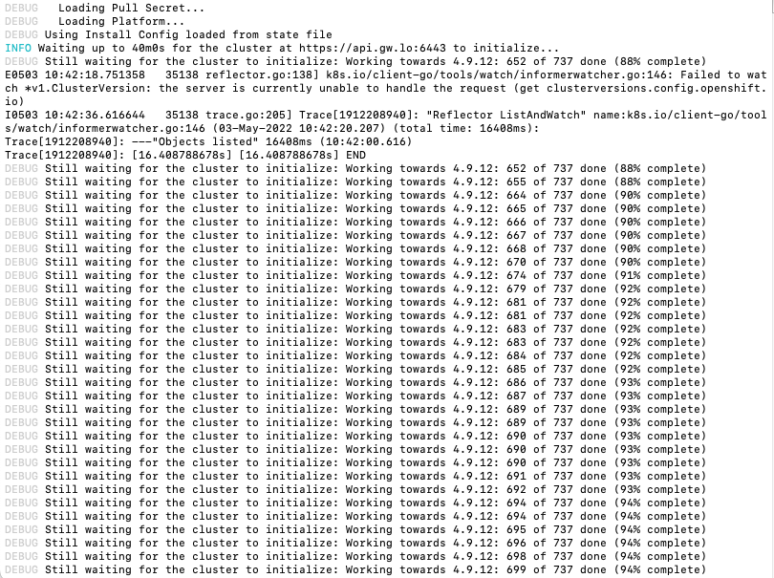

Slide 52
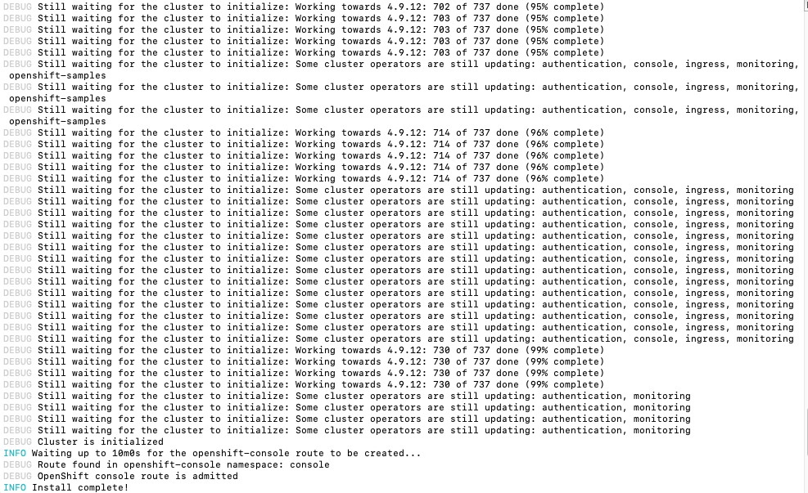

Slide 53
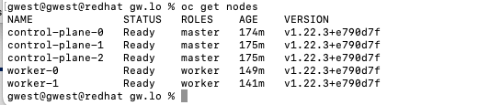

Slide 54
More Info
Where to get:
https://console.redhat.com/openshift/downloads#tool-mirror-registry
Blog:
https://cloud.redhat.com/blog/introducing-mirror-registry-for-red-hat-openshift
My Scripts
https://github.com/glennswest/mirrorregistry

